Slide 1

A probabilistic approach for interpretable deep learning in liver cancer diagnosis
Clinton Wang^{1,2}, Charlie Hamm¹, Brian Letzen¹, James Duncan¹
¹ Yale School of Medicine, Department of Radiology and Biomedical Imaging
² MIT Computer Science & Artificial Intelligence Laboratory

Slide 2
Explainable networks improve safety, accountability
MRI
Diagnosis
Validation
Decision-making
Reporting
Explanation
Neural
Network

Slide 3
Explain predictions using radiological terms
Diagnosis
MRI
Explanation
Neural
Network
MRI features present
Previous work: Kim et al. (2018). ICADx: Interpretable computer aided diagnosis of breast masses. In Proc. SPIE Medical Imaging.

Slide 4
Explain predictions using radiological terms
Hyperenhancement
Diagnosis
MRI
Explanation
Central scar
Neural
Network
MRI features present

Slide 5
Constraints: pretrained network, weakly labeled features
Network only trained to diagnose
MRI
Diagnosis
Explanation (MRI features)
MRI Dataset
Fully labeled diagnoses
Weakly labeled features

Slide 6
Approach overview
MRI
Diagnosis
MRI features
Choose hidden layer
Infer features in input MRI from activations
Sample activations
Get empirical activation distributions
Estimate feature probabilities

Slide 7
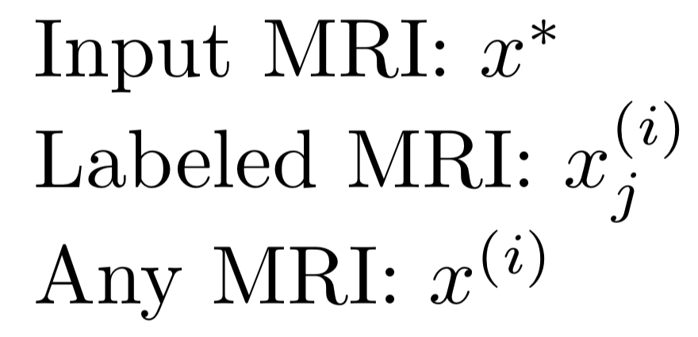
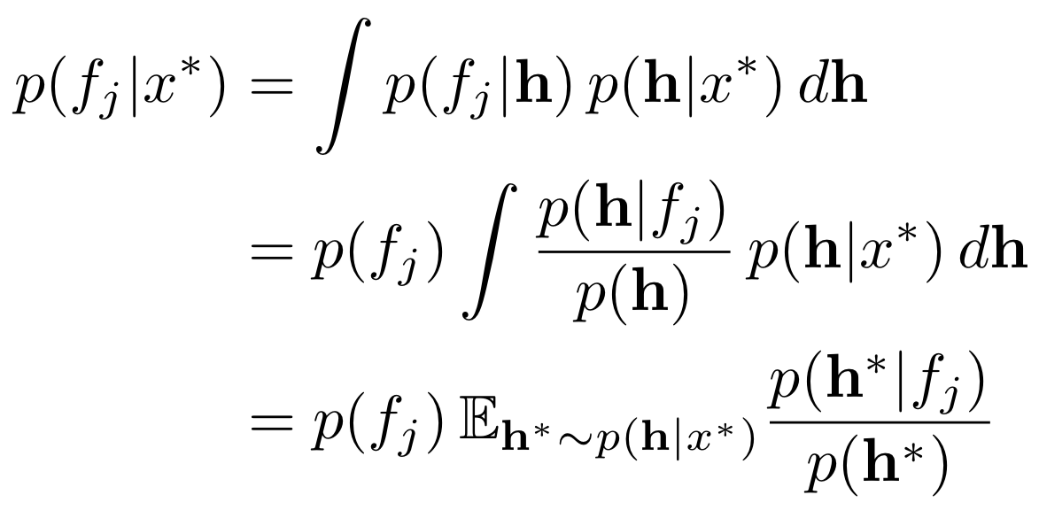
Find probability of each feature given input MRI
Hidden layer activations
x
h
y
MRI
Diagnosis
f_{j}
Presence of MRI feature j
Find

Slide 8
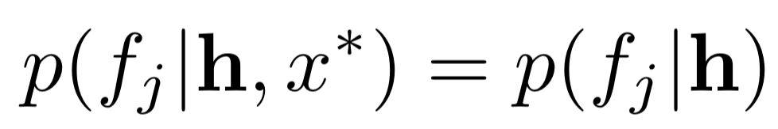
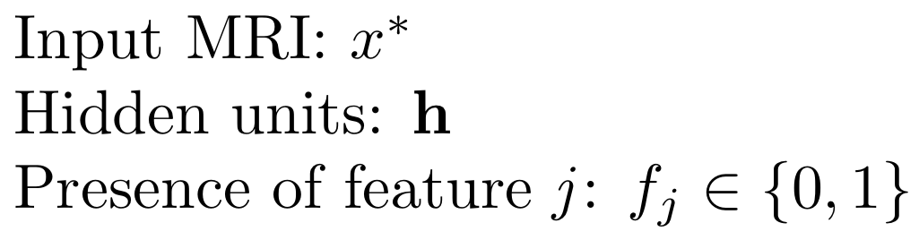
Key assumption: hidden layer preserves feature probability
Assume

Slide 9
Probability of feature given input MRI

Slide 10
Probability of feature given input MRI

Slide 11
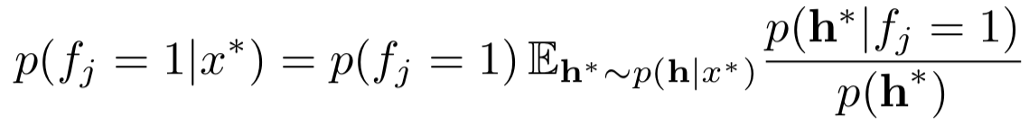
Probability feature is present in input MRI

Slide 12
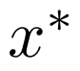
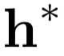
Sample with augmentation, dropout
Input MRI
Augmentation
Dropout

Slide 13
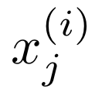
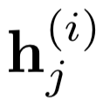
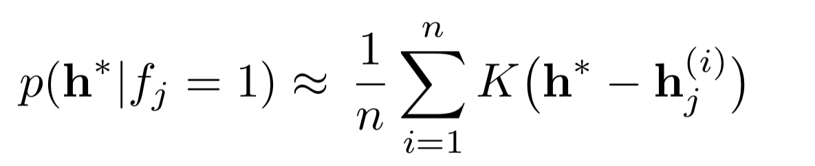
KDE on empirical conditional distribution
Labeled MRI

Slide 14
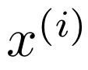
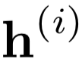
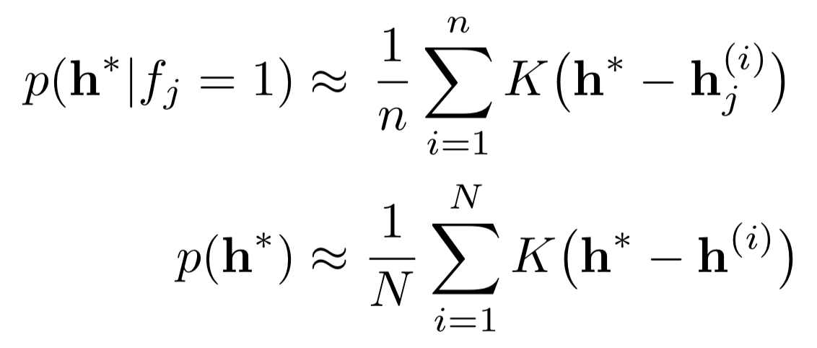
KDE on empirical marginal distribution
Any MRI

Slide 15
KDE scales poorly with dimensionality
Choose K to minimize effect of uninformative dimensions (Liu et al. 2007*)
*Liu, H., Lafferty, J., & Wasserman, L. (2007, March). Sparse nonparametric density estimation in high dimensions using the rodeo. In Artificial Intelligence and Statistics (pp. 283-290).

Slide 16
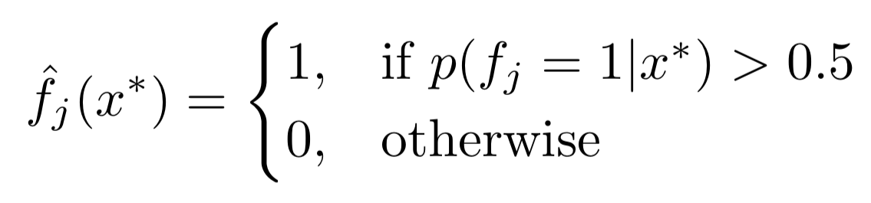
Binary decision rule for feature presence

Slide 17
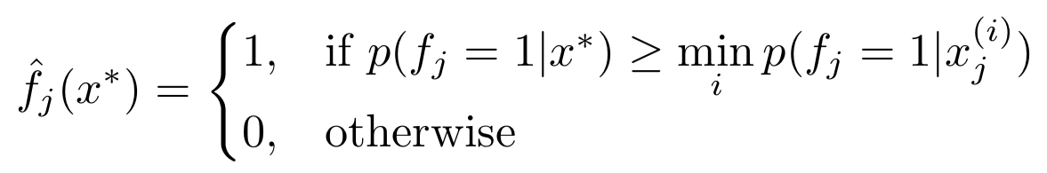
Compare relative probabilities
examples of feature j

Slide 18
Removes dependence on prior
examples of feature j

Slide 19
Experiment: liver cancer diagnosis
Network only trained to diagnose liver lesions
MRI
Diagnosis
Explanation
(MRI features)
MRI Dataset
Fully labeled diagnoses (6 classes)
Weakly labeled features (14 types)

Slide 20
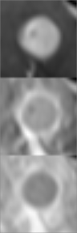
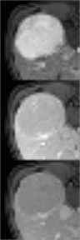
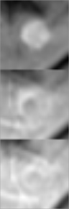
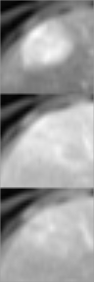
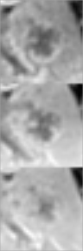
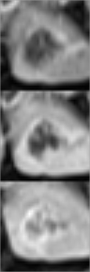
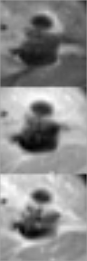
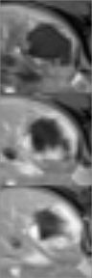
8 examples of liver lesions (4 benign, 4 malignant)
Which lesions are malignant?
20s
70s
3min
Time after contrast injection
T1-w contrast-enhanced MRI (cropped)

Slide 21
Lesion classification is hard
Malignant
Benign
20s
70s
3min
Time after contrast injection

Slide 22
Data summary
6 types of liver lesions (434 training, 60 test)
Benign
Focal nodular hyperplasia
Cavernous hemangioma
Hepatic cyst
Malignant
Hepatocellular carcinoma
Colorectal cancer metastasis to the liver
Intrahepatic cholangiocarcinoma

Slide 23
Data summary
6 types of liver lesions (434 training, 60 test)
Benign
Focal nodular hyperplasia
Cavernous hemangioma
Hepatic cyst
Malignant
Hepatocellular carcinoma
Colorectal cancer metastasis to the liver
Intrahepatic cholangiocarcinoma
14 features (140 labels, 154 in test lesions)
Central scar
Infiltrative appearance
Heterogeneous lesion
Nodularity
Enhancing rim/capsule
Washout
Thin-walled mass
Hypoenhancing core/mass
Progressive hyperenhancement
Progressive centripetal filling
Nodular or discontinuous enhancement
Isointense on venous/delayed phase
Arterial phase enhancement
Hyperenhancing mass on delayed phase

Slide 24
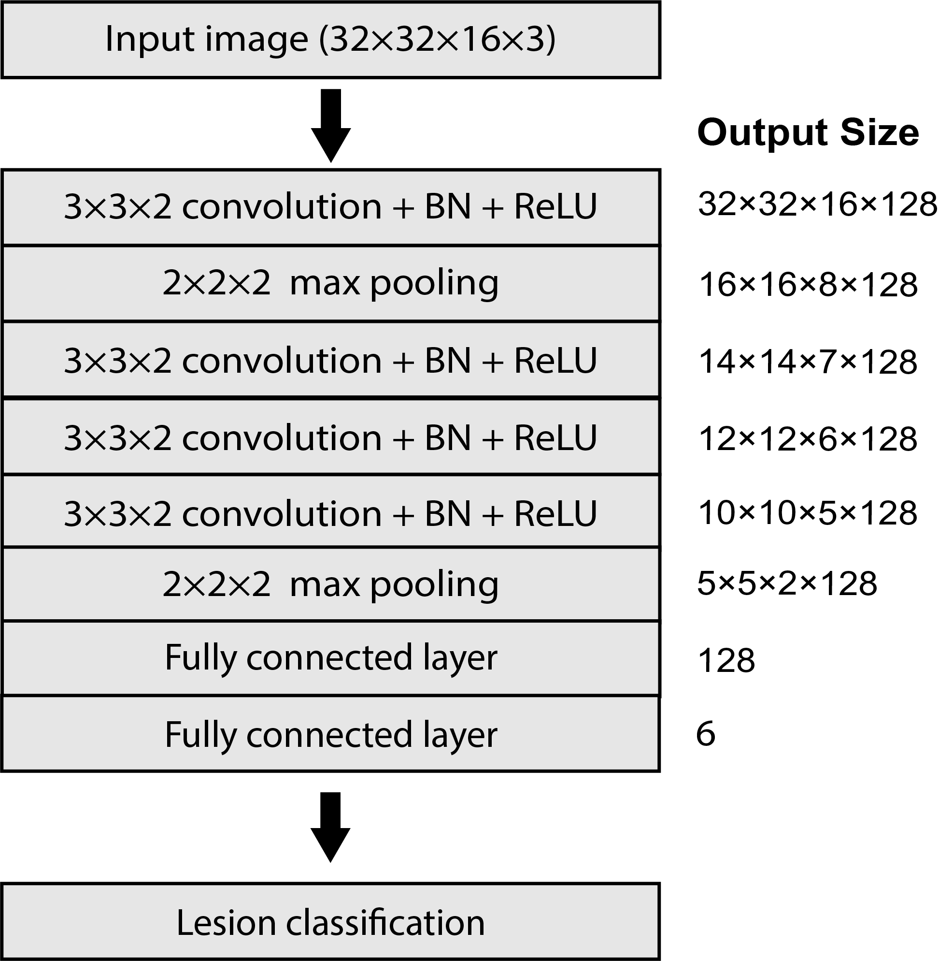
Model trained to 90% accuracy
Diagnosis

Slide 25
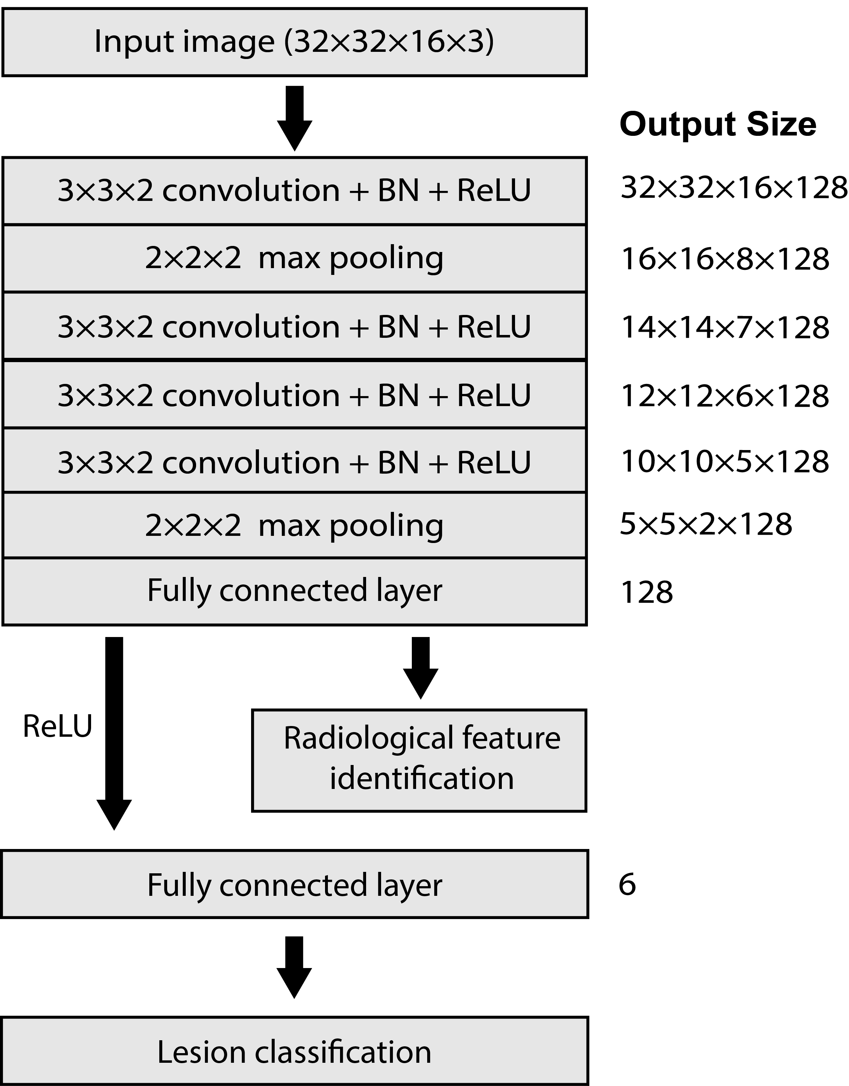
Perform feature inference
MRI features
Diagnosis

Slide 26
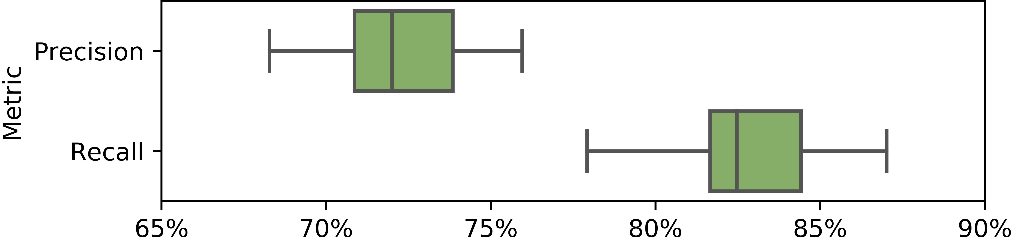
Feature identification performance
Results from 20 repetitions.

Slide 27
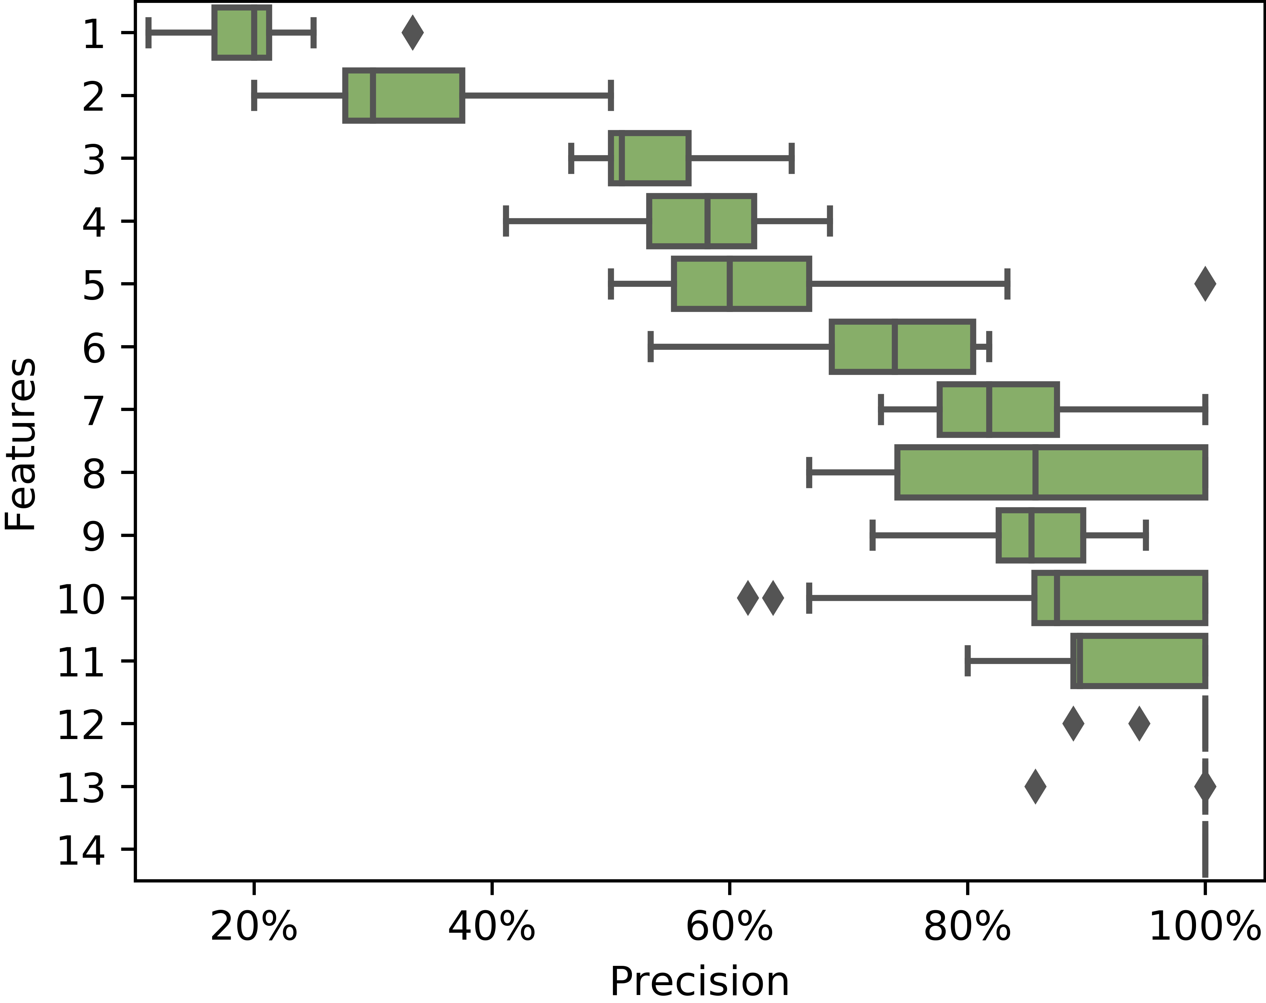
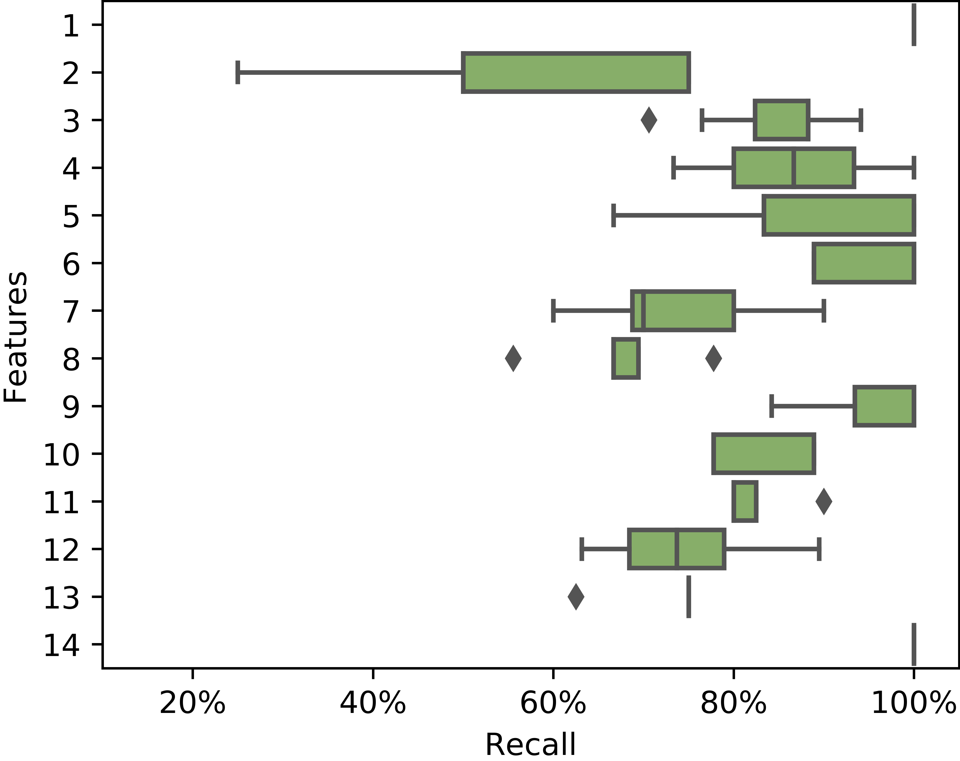
Bad feature performance reveals model weaknesses
1: central scar
2: infiltrative appearance
3: heterogeneous lesion
4: enhancing rim/capsule
5: nodularity
6: isointense on venous/delayed phase
7: hypoenhancing core
8: washout
9: progressive hyperenhancement
10: progressive centripetal filling
11: nodular or discontinuous enhancement
12: arterial phase enhancement
13: hyperenhancing mass on delayed phase
14: thin-walled mass

Slide 28
Bad explanations could detect bad diagnoses
Predicted lesion class
Input MRI
HCC
Predicted MRI features
20s
70s
3min
Arterial phase hyperenhancement
Isointensity in venous/delayed phase
Capsule/pseudocapsule
Heterogeneous lesion
True lesion class
FNH

Slide 29
Bad explanations could detect bad diagnoses
Predicted lesion class
Input MRI
HCC
Predicted MRI features
Arterial phase hyperenhancement
Isointensity in venous/delayed phase
Capsule/pseudocapsule
Heterogeneous lesion
Incompatible with predicted lesion class
True lesion class
FNH
Features compatible with HCC
Arterial phase hyperenhancement
Washout
Capsule/pseudocapsule
Heterogeneous lesion

Slide 30
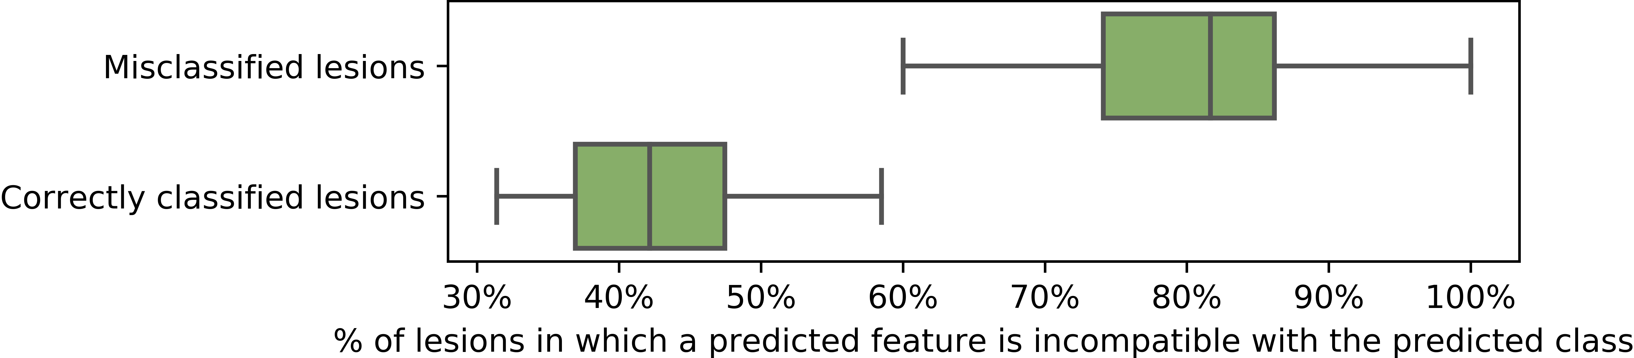
Bad explanations could detect bad diagnoses

Slide 31
Future directions
Tradeoff between explanation quality and error detection
Performance with more/negative labels
Comparison to few-shot learning
Assumes optimal networks learn radiological features

Slide 32
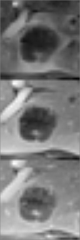
Contributions
Demonstrated an approach to explain neural network predictions in terms that radiologists understand
Also debugs models, identifies failure modes, and detects errors
A post-hoc method built from weak labels is easier to implement
Diagnosis
Acknowledgments
RSNA Research Resident Grant #RR1731
NIH/NCI R01 CA206180
Dr. Polina Golland
Dr. Julius Chapiro, Dr. Ming De Lin
Explanation
Neural
Network
MRI

Slide 33
Appendix: List of radiological features

